Slide 1
DCS
Introduction

Slide 2
Agenda
DCS Base Function Introduction
DCS Rule Edit

Slide 3
1. DCS Base Function Introduction
What is DCS ?
Benefits of using DCS
Stocker Partition Zone Concept
DCS WatchDog

Slide 4
1.1 What is DCS ?
DCS/MCS Concept :
What is DCS
DCS is the abbreviation of Dispatching Control System (Automatic Dispatching System). DCS is the brain in the entire conveying system. Its main function is to proactively decide which dispatch orders to send to MCS to execute the conveyance according to the production needs of the machine and the status of the Stocker, and to send the Cassette to the machine or the Stocker. If there is no DCS to dispatch, you can only use the manual input of Cassette and destination from OPI to place a dispatch order to MCS.
What is MCS
MCS is the abbreviation of Material Control System, which is to execute the delivery order of MES (there are two kinds, one is OPI manually, the other is DCS automatic), MCS is connected to AMHS (Auto Material Handing System) to control AGV, Stocker, RGV and other transmission equipment.
Notes:
DCS 是Dispatching Control system (自動派貨系統) 的縮寫, DCS 在整個傳送系統中是大腦, 主要的功能在於根據機台RUN 貨的需要及Stocker 的狀況, 主動決定要下那些派貨命令給MCS 來執行傳送, 把Cassette 傳到機台上或Stocker 上.如果沒有DCS 派貨, 只能使用從OPI 上手動輸入Cassette 及目的地來下派貨命令給MCS.
MCS 是Material Control system的縮寫, 在於執行從MES 過來的
派貨命令(有兩種, 一種是OPI 手動下的, 另一種是DCS 自動下的), MCS 底下接AMHS (Auto Material Handing System)來控制AGV, Stocker, RGV 等傳送設備.

Slide 5
DCS Architecture
Where to go
What’s Next

Slide 6
1.2 Benefits of using DCS
Replace manual delivery of goods by personnel, reducing the use of manpower
Personnel reduction operation MO(miss Operate)
Easy to operate and control
Increase transmission efficiency
Increase productivity
High integration with MCS
Notes:
1. 取代人員手動派貨, 降低人力的使用
2. 人員減少操作 MO
3. 方便操作與控管
4. 增加傳送效率
5. 提高產能
6.與MCS高度整合

Slide 7
1.3 Concept of Stocker Partition Zone
Partition is an entity, zone is a virtual concept, generally a larger Stocker will be divided into two partitions on the left and right, each partition has 101 to 105 zones, when the Stocker completes the partition division,
each shelf belongs to a specific partition,
and does not belong to any zone.
Each partition must be divided into zones according
to the number of shelves. For example, partition 1 has 50 shelves,
which can be divided into 2 101 zones, 10 102 zones, 36 103 zones, and 1 each for 104 zone and 105 zone.
101 zone
102 zone
103 zone
Partition 1
104 zone
105 zone
Stocker
101 zone
102 zone
Partition 2
103 zone
104 zone
102
103
105 zone
101
104
Partition 1
Partition 2
Stocker
101 zone= 2
101 zone= 2
102 zone=10
shelf
102 zone= 2
103 zone=36
103 zone=16
104 zone= 1
104 zone= 1
105 zone= 1
105 zone= 1
Notes:
(1)Partition 是實體的, zone 是虛擬的概念, 一般較大型的Stocker 會必區分成
左右兩個partition, 每個partition 下有101 到105 zone, 一但Stocker 完成partition 分割,
每個shelf 必屬於特定的partition, 但不屬於任何zone.
(2)每個partition 必須依shelf數量區分zone, 例如partition 1 有50
個shelf, 可以分成101 zone 有2個,102 zone
有10個, 103 zone 有36個, 104 zone 與
105 zone 各1個

Slide 8
1.3 Concept of Stocker Partition Zone
The usage of Zone is related to DCS, because DCS will be different according to different transmission types, such as EQP (machine) to Stocker, Stocker to Stocker, stocker to EQP, and the Stocker Zone used.
(1) 101 zone → DCS Pull Zone
DCS is used in Stocker to Stocker
(2) 102 zone → DCS Push Zone
DCS is used in Stocker to Stocker
(3) 103 zone → common zone
DCS is used when the EQP returns to the stocker
A
G
V
1
0
0
CLA130
CLA120
CLA110
CLA230
CLA220
CLA210
EQP to STK
S
T
K
01
SPT80
SOR20
S
T
K
05
RIE10
S
T
K
06
RIE30
I
E
X
10
I
E
X
20
I
E
X
30
I
E
X
40
MOV10
RIE20
RIE40
CLA30
MVI10
STO10
RIE50
CLA40
MOR20
RIE60
MOR30
STO20
STK to STK
CLA50
MOV20
RIE70
STO30
(4) 104 zone → abnormal zone
DCS does not use, MCS uses exception
cassette. Use when the goods are abnormal
shelf
(5) 105 zone → abnormal zone
(Not currently used)
MSH
10
MOR
10
MEL
10
(STKC block shelf)
STK03
S
T
K
02
RGV01
RGV02
MSR
10
STK04
SPTA0
I
E
X
50
I
E
X
60
I
E
X
70
I
E
X
80
I
E
X
A0
I
E
X
B0
I
E
X
C0
I
E
X
D0
I
E
X
E0
SPTB0
SOR10
STK to EQP
Notes:
Zone 的用法與DCS 有關係, 因為DCS 會根據不同的傳送type例如EQP(機台) to Stocker, Stocker to Stocker, stocker to EQP , 所使用的Stocker Zone 而不同
(1)101 zone → DCS Pull Zone
DCS 使用於Stocker to Stocker 時
(2)102 zone → DCS Push Zone
DCS 使用於Stocker to Stocker 時
(3) 103 zone → common zone
DCS 使用於機台回 stocker時
(4)104 zone → abnormal zone
DCS 不使用, MCS 使用異常cassette貨異常shelf 時使用(STKC block shelf)
(5)105 zone → abnormal zone
DCS 不使用, MCS 使用異常cassette貨異常shelf 時使用(目前不使用)

Slide 9
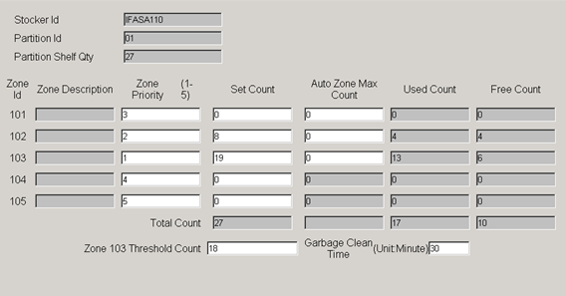
1.3 Concept of Stocker Partition Zone
Stocker ZoneSet
Zone capacity setting
The number of zones used
Balance water level
102→103 zone
recovery time

Slide 10
1.4 DCS WatchDog
WD_Clean (Unload Request)
WD_LoadRequest (Pull)
WD_Push
WD_Stocker
WD_Stocker
WD_Clean
STK→STK balance
STK→STK empty collection
STK->STK Garbage Collect
EQ→STK
WD_Push
WD_LoadRequest
STK→STK 102 zone
STK→EQ
EQ→EQ

Slide 11
1.4.1 WD CLEAN : EQP back to single stocker
Purpose: When the Port sends a ULRD (Unload request), the DCS sends the Cassette located on the port of the
EQP to the 103 zone of the designated Stocker (called Return Stocker) automatically.
Concept : (1) EQP must be in remote state, and Tool Status cannot be down before DCS will execute
(2) The Return Stocker or Return Stocker Group of each EQP Port must be set. When the Stocker of
Priority 1 is full or down, DCS can send it to the Stocker of the next priority
shelf
Partition 1
Partition 2
EQP Port
Stocker
EQP
Notes:
目的 : 當Port 發ULRD (Unload request), DCS 把位於機台Port 上的Cassette
自動下傳送命令送 回指定的Stocker(稱為return Stocker)的103 zone
觀念 : (1)機台 必須為turn remote 的狀態, 且Tool Status 不能為down DCS 才會執行
(2)須指定每個機台Port 的return Stocker, 也可指定return Stocker Group, 當
Priority 1 的Stocker 滿了或down 時, DCS 可以派至下個priority 的Stocker
WD_Clean判斷條件:
1.EQ的force_return_flag要勾選
2.EQ狀態不為down.
3.有設定return stocker by process.
4.EQ Port有設定return stocker/group.
5.Return stocker未滿且不是down的狀態.

Slide 12
1.4.1 WD CLEAN : EQ back to stocker Group
Purpose: The return stocker can also set the stocker group, and set the priority
(priority 1: Stocker 1, priority 2: Stocker 2),
when the stocker 1 is full or down, DCS can be sent to the stocker 2
AGV
Partition 1
Partition 2
return
Stocker
Group
Stocker 2
Partition 1
Partition 2
Eqp port
Stocker 1
EQP
Notes:
目的 : 機台return 的stocker 也可以設定stocker Group, 並設優先權(priority 1 : Stocker 1,
priority 2 : Stocker 2), 當stocker 1滿了或down 時, DCS 可以派至stocker 2

Slide 13
1.4.1 WD CLEAN : EQ back to stocker by process
Purpose : The EQP return stocker can be set to directly return to the supply stocker of the next process,
which can reduce one transfer. DCS will decide which stocker to be destination according to Model No,
Abbr No, and process ID.
The following figure takes the machine CVD100 as an example. DCS will determine the return stocker according to the next process of the lot after the CVD100 machine runs.
(MOV300)
EQP
Stocker 3
Stocker 2
AGV
Partition 1
Partition 1
Partition 2
EQP
Stocker 1
(IEX500)
* : Unrestricted
Partition 1
Partition 2
Model No | Abbr No | Process id | Return stk | partition
* | * | AS-IEX | Stocker 1 | 02
V42H4-A1 | C3 | TH-IEX | Stocker 3 | 01
* | * | AS-MOV | Stocker 2 | 02
EQP
EQP Port
EQP
(CVD100)
(IEX100)
Notes:
目的 : 機台return 的stocker 也可以設定直接return 到下製程的supply stocker , 可減少一次傳送
, DCS 會根據Model_No、Abbr_No、process ID 來決定要派至哪個stocker,
下圖以機台CVD100為例, DCS會根據CVD100 機台run 完的lot 的下製程來決定return stocker

Slide 14
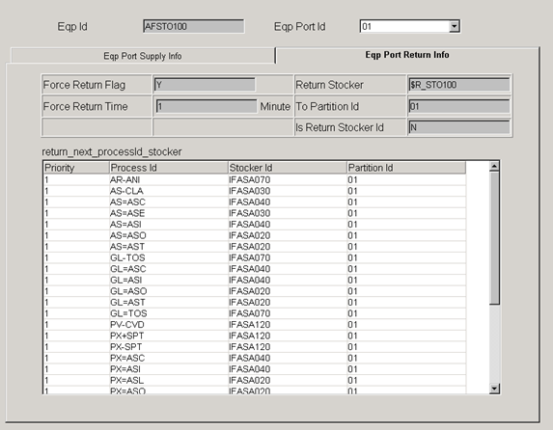
1.4.1 WD CLEAN : EQ back to stocker by process

Slide 15
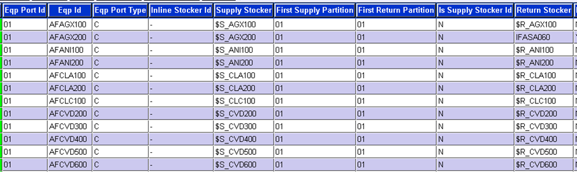
EQP Port Return Stocker setting
EQP Port

Slide 16

EQP Port Clean Stocker setting (Example #1)
WD_Clean will confirm when the cassette runs on ACSPT100 Port 1 If the manufacturing lot in cassette Model_no=V42H4-A1, Abbr_no=C3, Next_Process_Id=GL_IEX, the cassette will be returned to 01 Partition of ICAS0370.
EQP Port
N:StockerGroup
Y:Stocker
Clean Stocker
Notes:
表示當卡匣在ACSPT100 Port 1 Run完後，WD_Clean會確認
如果該卡匣Model_no=V42H4-A1 ，Abbr_no=C3，Next_Process_Id=GL_IEX時，會將卡匣Return 到ICAS0370的01 Partition。

Slide 17

EQP Port Clean Stocker setting (Example #2)
WD_Clean will confirm when the cassette is run in ACSTO100 Port1. If the cassette Next_Process_Id=AS-CVD, the cassette will be returned to the Stocker Group of $R_S031S071. According to the Stocker Group Map setting, the cassette will be dispatched to ICAS0030 Partition 01 first, and the second priority will be dispatched to ICAS0070 Partition 01.
EQP Port
N:StockerGroup
Y:Stocker
Clean Stocker
Stocker Group Map
Notes:
表示當卡匣在ACSTO100 Port 1 Run完後，WD_Clean會確認
如果該卡匣Next_Process_Id=AS-CVD時，會將卡匣Return 到$R_S031S071的Stocker Group，依Stocker Group Map 設定，卡匣會優先派到ICAS0030 Partition 01 ，第二優先會派到ICAS0070 Partition 01 。

Slide 18
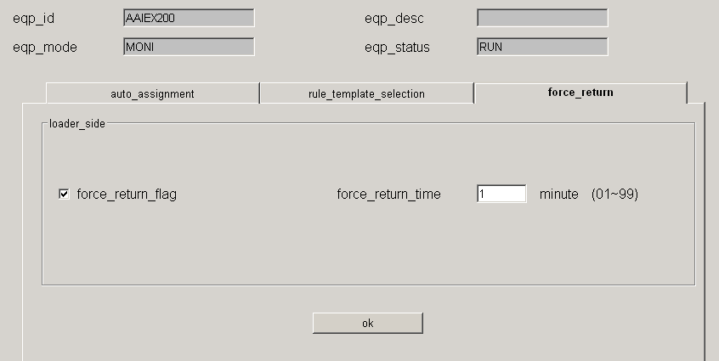
WD_CLEAN : EQ → Force Return
Force Return Flag → Turn on the function of automatically sending the goods back to the Stocker after the EQ
run is finished.
Force Return Time → Wait a few minutes on the port before being dispatched back to the Stocker (For EQ->EQ
direct transmission can be realized)
Notes:
畫面中CHECK BOX Force Return Flag 的選擇
打勾 →機台run完貨自動派回Stocker的功能開啟
不打勾 → 關閉
畫面中 Force Return Time →輸入的時間代表Cassette run完後會在port上待幾分鐘才會被派回Stocker

Slide 19
1.4.2 WD Load request
Purpose : When the port of EQP sends LDRQ (load request), DCS automatically finds the WIP of this machine in
Supply Stocker (set as stocker 1), and sends the Cassette with higher priority (more urgent) to the port
of EQP.
Concept : (1) WIP is in the (101/102/103) zone of Supply Stocker, and can be directly sent to EQP by DCS.
(2) If the supply stocker is a group (ex: stocker1+stocker2 is a stocker group),when the WIP located in
Stocker 2 can send directly to LDRQ EQ, but the transmission distance is longer than stocker1 to EQ.
OHT
Partition 1
Partition 1
Stocker 3
Stocker 2
Stocker 1
Partition 1
EQP
EQP Port
(IEX100)
Notes:
目的 : 當機台的port 空了發LDRQ (load request), DCS 自動尋找此機台在Supply Stocker
(設定為 stocker 1)的WIP, 並把priority 較高的cassette (比較急的)送到機台的port 上去
觀念: (1) WIP 是在Supply stocker 的(101/102/103)zone, 都可以直接被DCS 送上機台
(2) 如果把機台的supply stocker 改成Group (stocker 1 + stocker 2), 則位於Stocker 2
的cassette 也能夠直接被機台派上去, 只是傳送距離較長.

Slide 20
1.4.2 WD Load request : Direct transmission
Purpose : When the port of EQP sends LDRQ (load request), DCS will also look for the WIP that has been
completed on the EQP of the same bay, DCS can directly issue the delivery command to transfer this
WIP to this EQP.
Concept : EQP port can set the force return time, let the finished Cassese stay in the EQP port, and increase the
chance of direct transmission
OHT
Partition 1
EQP
Stocker 1
(CVD200)
Stocker 3
Partition 1
EQP
EQP Port
(IEX100)
Notes:
目的 : 當機台的port 空了發LDRQ (load request), DCS 也會尋找 同一個bay 上是否有上製程的機
台上已有run 完的WIP, DCS 可以直接下派貨命令把此WIP 傳至此機台
觀念: (1) 上製程機台的port 可設定force return time, 讓run 完的貨多停留在機台port 等待,
增加直傳的機會

Slide 21
EQP Port Supply Stocker setting
EQP Port
WD_LoadRequest self dispatch
Also have to look at SupplyStocker settings
Notes:
WD_LoadRequest自派
還須看BRM的SupplyStocker設定

Slide 22
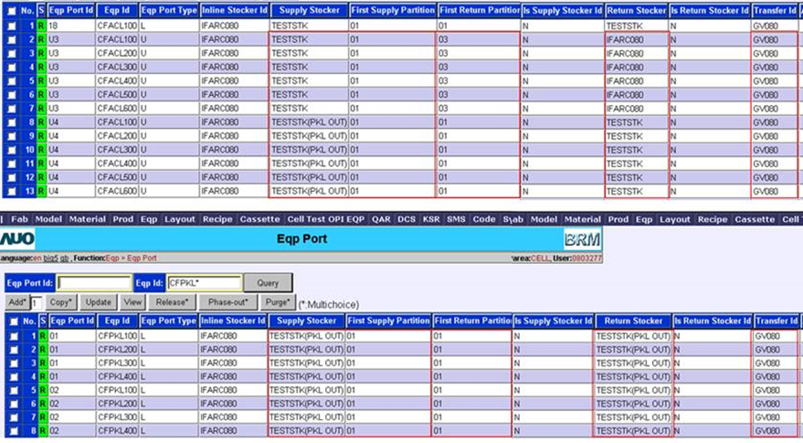
1.4.2 WD Load request : Direct transmission
EQ→EQ for direct transfer, the Transfer ID of the BRM must be the same.
Concept : Force return time can be set for the port of the upper process machine, so that the finished goods can
stay at the port of the machine and wait, increasing the chance of direct transmission
Notes:
EQ→EQ直傳時, BRM的Transfer ID必須一致.
觀念: (1) 上製程機台的port 可設定force return time, 讓run 完的貨多停留在機台port 等待,
增加直傳的機會

Slide 23
1.4.2 WD Load request : Pull Transfer
Purpose : When the port of EQP sends LDRQ (load request), DCS finds that the most urgent WIP of this EQP is not
on the Supply Stocker, and the second most urgent WIP is on the supply stocker, DCS Load Request will
issue two transmission commands at the same time, with the highest priority It is sent to 101 Zone
(Pull transfer) of supply stocker, and to prevent machine IDLE, send the WIP of priority 2 to EQP.
WIP A: Priority 2
OHT
Partition 1
Partition 1
WIP B: Priority 1
Stocker 3
Stocker 2
Partition 1
Stocker 1
EQP
EQP Port
(IEX100)
Notes:
目的 : 當機台的port 空了發LDRQ (load request), DCS 發現此機台最急的 WIP 不在supply stocker上
, 而次急的WIP 在supply stocker 上, DCS Load Request 會同時下兩個傳送命令, 把priority 最高
的派至supply stocker 的101 Zone(Pull transfer), 而為防止機台IDLE, 把priority 2 的WIP 送至機台

Slide 24
DCS/MES (Loading W.D.)
R10
L1 U1
G10
L1 U1
STK10
3
LDRQ
2
STK20
101
102
103
3
1
S10
4
Are you sure that the cassette qty is enough to deliver?
Are you sure the delivery does not exceed max_pull_cnt ?
Notes:
確定shelf qty夠派入?
確定派送不超過max_pull_cnt ?

Slide 25
DCS/MES (Loading W.D.)
R10
L1 U1
G10
L1 U1
STK10
LDRQ
2
1
STK20
101
102
103
3
3
S10
4

Slide 26
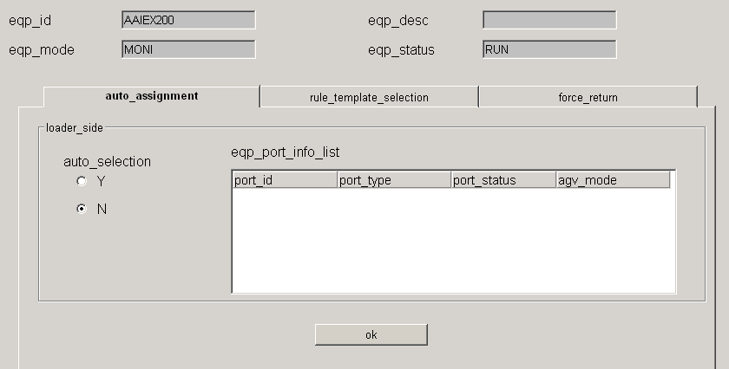
WD_LoadRequest : EQP → Auto Assignment
Features : Control whether the specified machine should be automatically dispatched, that is, the function that
WIP can be automatically dispatched to the machine
Automatic delivery switch
Notes:
功能 :
1: 控制指定機台是否要RUN 自動派貨,就是WIP能自動被
派上機台的功能
畫面中RADIO BOX Auto Selection的選擇
Y → 自動派上機台的功能開啟
N → 關閉

Slide 27
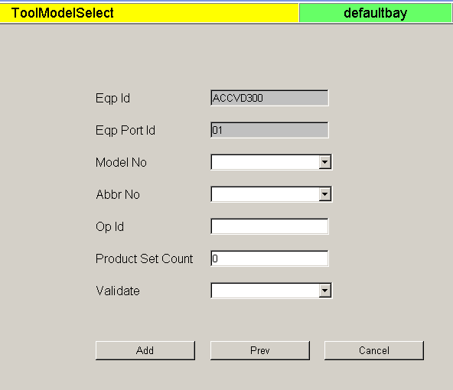
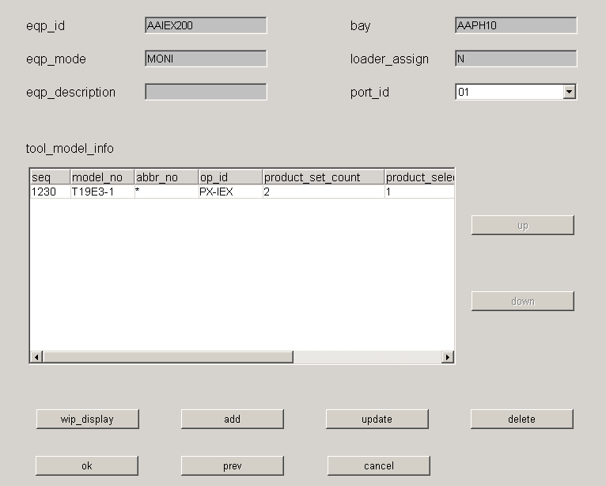
WD_LoadRequest : EQP → ToolModelSelect
Product Set Count: Set the upper limit
Product Select Count: Represents the number of Cassettes that have been completed
2. When setting, use * to represent all (no limit)
Defines the quantity that this EQ port can send.
Notes:
1. 表中Product Set Count 代表此筆設定的上限
, 而 Product Select Count代表已經run 過的Cassette 數量
2.設定時使用 * 來代表全部 (不卡限制的意思)

Slide 28
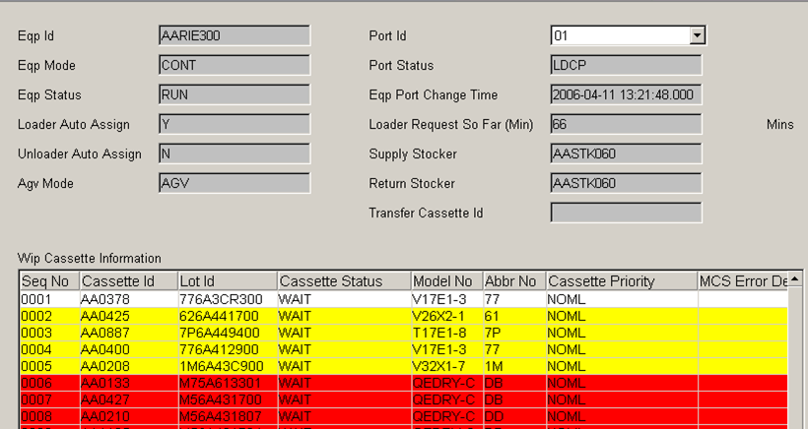
OPI Dispatch WIP(Work In Process) Function
Dispatch WIP can divide WIP into 3 categories for machine + port:
In the picture, the white background (can be dispatched and in Supply Stocker) is dispatched to the machine port.
In the picture, the yellow background(can deliver but not in Supply Stocker) is a chance to be done by DCS for cross-bay transmission (WD_Pull)
can be dispatched and in Supply Stocker
can be dispatched and not in Supply Stocker
Cassette that cannot be delivered
Notes:
Dispatch WIP 針對機台 + port 可以把WIP 分成3類, DCS Load request 只會
針對圖中白色底(可以派貨且在Supply )派至機台port 上, 而圖中黃色底
(可以派貨但不在Supply )的Cassette 則有機會被DCS 做跨Bay 傳送 (WD_Pull)

Slide 29
1.4.3 WD Push Transfer : Single Supply Stocker
Purpose : Assuming that the EQP's supply Stocker is Stocker 1, when DCS finds that the WIP required by the
EQP is not in the supply stocker, DCS will send the WIP to supply Stocker 1.
Concept : (1) The supply stocker needs to set the kanban to control the upper limit of the WIP of each process to
ensure that there is enough storage space to store the cassette of each process.
(2) DCS Push will only pull the cassette located in the Stocker 103 zone, the cassettes located in the
101 zone and 102 zone are protected and will not be pulled by other stocker pushes.
OHT
Partition 1
Partition 1
Set kanban to control the upper limit of WIP per process
Stocker 3
Stocker 2
The Lot process in Cassette is GL-IEX
Stocker 1
Process id | Set count | Used count
GL-IEX | 5 | 2
….. | …. | ….
Partition 1
EQP
EQP Port
(IEX100)
Notes:
目的 : 假設機台的supply Stocker 為Stocker 1, 當DCS 發現機台所要的WIP 不在supply stocker
時, DCS 會把此WIP 派至supply Stocker 1
觀念: (1) supply stocker 需設定 kanban , 來控制每道製程WIP 的上限, 以確保此 stocker
內的機台所需run 的每道製程都有足夠的儲位可存放
(2) DCS Push 只會拉位於Stocker 103 zone 的cassette, 位於101zone 與102 zone 的
cassette 受到保護而不被其它stocker push 拉走

Slide 30
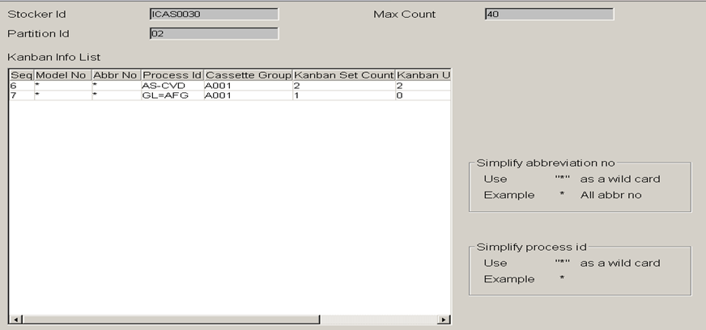
WD_Push : Stocker ZoneSet - Kanban setting

Slide 31
1.4.3 WD Push Transfer : Same bay no push
Purpose : If the stocker where the WIP is located already has a processable EQP, in order to prevent it from being
pulled away by other EQPs with the same process capability, DCS can set this function to avoid mutual
pulling.
IEX200 and IEX100 have the same process capability. In order to prevent the WIP in Stocker 3 from being pulled to Stocker 1 and then pulled to Stocker 3, causing mutual pull, Same Bay No Push will be set.
OHT
Partition 1
Partition 1
Stocker 3
Stocker 2
EQP
(IEX200)
Stocker 1
Partition 1
EQP Port
EQP
(IEX100)
Notes:
目的 : 如果WIP 所在的stocker 已經有可以製程的機台時, 為防止此wip 被位
於其它 Stocker 的相同製程能力的機台拉走, DCS 可設定執行此功能
來避免互拉的情形
IEX200與IEX100有相同製程能力，為了防止在Stocker 3 的WIP被拉至Stocker 1 ，
又被拉至Stocker 3 ，造成互拉的情形，會設定 Same Bay No Push

Slide 32
1.4.3 WD Push Transfer : Same stocker group no push
Purpose : If the Stocker where the Cassette is located is already in the Supply Stocker STK100 of this EQP, but the
Cassette Priority is lower at this time, then the Cassette does not need to be pulled to the Supply
Stocker STK200 with the higher Priority, because the goods are not required for this EQP. It's all in the
Supply Stocker, so in order to reduce ineffective handling, this Cassette doesn't need to be handled.
OHT
Partition 1
Partition 1
Stocker 3
STK100
EQP
STK200
Return
Stocker
Group
(IEX200)
Partition 1
Eqp port
EQP
(IEX100)
Notes:
目的 : 如果Cassette所在的Stocker 已經在此機台的Supply Stocker STK100時，但是此時這個Cassette Priority 較低，那此Cassette是不需要被拉到Priority較高的Supply Stocker STK200去，因為貨物對於此機台而言都是在Supply Stocker當中，所以為了減少無效的搬運，此貨物便不需要搬運。

Slide 33
1.4.4 WD Stocker : Stocker Balance (STK to STK)
Purpose : When the stocker's Partition stores the number of Cassettes reaches the set amount (Threshold), in
order to avoid to over threshold, DCS will start to send Cassettes to other Stockers .
Concept : (1) Stockers can be set to multiple groups according to Priority. When the Stocker of Priority 1 exceeds
the Threshold or down, DCS can send it to the Stocker of the next priority
(2) The oldest Cassette in the Stocker will be balanced first, except for the empty Cassette, because the
empty Cassette will not be balanced
(3) Balance only happens in 103 zone
Stocker 2
OHT
Partition 1
Threshold
Balance
Stocker 1
Stocker 2
Stocker 1
Partition 1
Notes:
目的 : 當stocker的Partition 的儲存cassette 數目達到一定的量時(Threshold)，為避免爆倉，DCS 會開始把 Cassette 送到其它 Stocker
觀念 : (1) Balance 過去的Stocker 可照Priority設多個在同一組Stocker Group,當Priority 1 的Stocker 超過
Threshold 或down 時，DCS 可以派至下個priority 的Stocker
(2) 放在Stocker 裡最久的Cassette 會被優先balance，但空cassette 除外， 因
為空cassette 不會被balance
(3) Balance 只發生在103 zone
Stocker的存貨量 =
CST存放在此Stocker中且在103 Zone數量 +
正在傳送進此座Stocker的CST數量 –
準備轉出此座Stocker的CST數量。

Slide 34

1.4.4 WD Stocker : Stocker Balance (STK to STK) (
Obtain the "balance_model_cat_list" setting from the system parameters, and filter out the goods that cannot be balanced. 。
Notes:
由系統參數取得 " balance_model_cat_list" 設定，將不能Balance的貨物過濾掉。

Slide 35
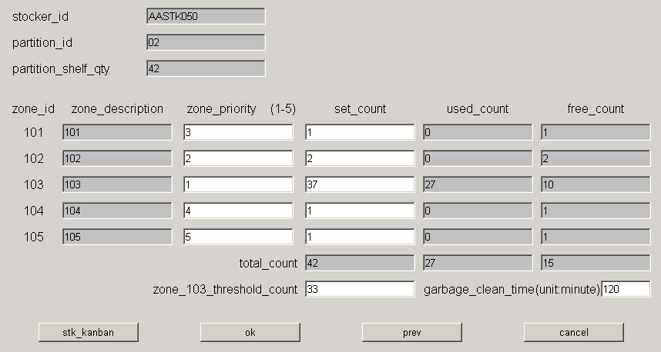
Stocker ZoneSet
Threshold : The number setting needs to be less than the set count of 103 ZONE

Slide 36
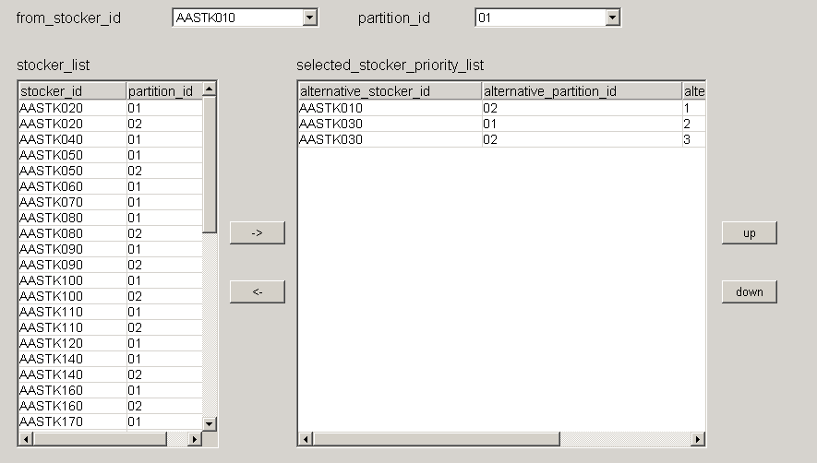
Stocker Balance
The bottom left window represents the list of all available Stocker/partitions.
The lower right window represents the selected Stocker/partition List and order
Notes:
左下邊的視窗代表所有可選的Stocker/partition List
右下邊的視窗代表已經選的Stocker/partition List 及順序

Slide 37
1.4.4 WD Stocker : Empty Cassette Collection
Purpose : The stocker will automatically send the specified empty cassette from the specified stocker to the
Stocker 102 zone
Concept : (1) The collection quantity and type of empty cassettes must be set in the kanban setting of Stocker
102 Zone.
(2) The order of the collected Stockers can be set. According to following figure. DCS will send command primary to the 103 zone of Stocker 1.
(3) Empty cassettes in zone 102 will not be collected by other Stockers.
Partition 1
OHT
Partition 1
Destination Stocker can set any count Empty Cassette user want, and the system will automatically dispatch cassette to other Stockers to collect
Stocker 2(priority 1)
Stocker 4 (priority 2)
Partition 1
Partition 1
Stocker 1
Stocker 3 (priority 3)
Notes:
目的 : stocker自動會從指定的stocker 把特定的空cassette 派到Stocker 102 zone
觀念: (1) empty cassette 的收集數量及種類須設定在Stocker 102 Zone 的kanban 設定裡
(2) 可設定收集的Stocker 順序, 以下圖為例 , DCS 會優先至Stocker 2 的103 zone
收集empty cassette派至Stocker 1, 如果stocker 2 已無empty cassette, DCS 會依次到
Stocker 4 及Stocker 3 拉empty cassette
(3) 位於102 zone 的 empty cassette 不會被其它的Stocker 收集

Slide 38
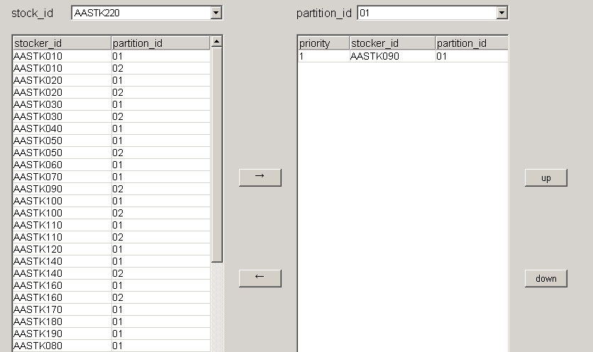
WD_Stocker : StockerEmptyCassetteCollection
The bottom left window represents the list of all available Stocker/partitions
The lower right window represents the selected Stocker/partition List and order
Notes:
左下邊的視窗代表所有可選的Stocker/partition List
右下邊的視窗代表已經選的Stocker/partition List 及順序

Slide 39
1.4.4 WD Stocker : Garbage Collection
Purpose : In order to prevent the cassette occupied the Stocker 101 and 102 zones too long result to
affecting the inter-bay transfer while cassette located in the Stocker 101
Concept: When cassette’s zone attribute changed, the cassette entity may not change the entity location. It may only change the cassette’s zone attribute.
Partition 1
OHT
101
Zone change
Cassette entities don't move
102
103
Partition 1
Stocker
Stocker 1
Notes:
目的 : 為了防止cassette 佔住Stocker 101 及102 zone 過久而影響跨bay 傳送,當位於Stocker 101
zone 與102 zone 的cassette 放超過一定的設定時間(garbage time)時,DCS 會把cassette 派
至103 zone
觀念: (1) 傳送zone 的改變, cassette 實體並不會移動, 只是在系統上, 此 cassette 所屬zone
的位置改變

Slide 40
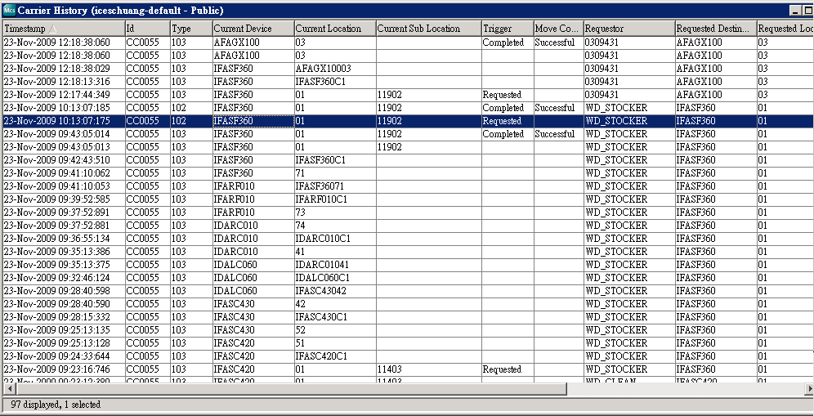
1.4.4 WD Stocker : Garbage Collection
  Kanban GarbageClean 空CST收集 Balance
Cell OPI: WD_PUSH WD_STOCKER WD_STOCKER WD_STOCKER
Array OPI: WD_PUSH WD_STOCKER_CST_CLEAN WD_STOCKER_EMPTY_CST WD_STOCKER_BALANCE
CF OPI: DDPUSXFR DDCLNGBG DDCOLEMP DDBALCAP DDSWPPOT DDLODREQ
GarbageClean
Balance

Slide 41
Gargabe Clean Time
重要
Stocker ZoneSet

Slide 42
DCS WD (Watch Dog Summary)
WD_Clean : Send Cassette on EQP back to Stocker
WD_LoadRequest : Dispatch Cassette to the desired EQP
WD_Push : move the cassette to the next step EQP’s nearest stocker
WD_Stocker : Adjust the Cassette in the Stocker according balance rule, empty collection rule, garbage collection rule.
Notes:
WD_Clean ：將機台上的Cassette派回到Stocker
WD_LoadRequest ：將Cassette派給所需的機台
WD_Push : 先將要跑的貨拉到最近的Stocker
WD_Stocker ：依據狀況調整Stocker內的Cassette

Slide 43
DCS Operational Architecture
WDLoadRequest
(Supply Stocker)
101
WDStocker
(Garbage Cassette Clean)
102
LDRQ
WDLoadRequest
(Direct transmission)
02
103
AASPT100
AAIEX100
01
101
102
103
ULRQ
WDLoadRequest
(Pull Cassette)
AASTK040
WDStocker
(Empty Cassette Collect)
WDPush
AASTK010
01
02
101
102
103
WDStocker
(Stocker Balance)
AASTK030
101
102
103
WDClean
(Return Stocker)
WDPush
AASTK050

Slide 44
2. DCS Rule Edit
How does DCS know what CASSETTE is required for each EQP?
It is determined by the dispatching rules edited in every DCS’s EQP setting.
The edited results of dispatching rules will be saved as Template ID for EQP setting to choose.
DCS Rule Edit
Template Rule Relationship with EQP
Template Rule Example
List Rule
Filter Rule
Sort Rule
Above Rule will composit Process Kanban Function
Carrier List
Carrier List
Carrier List
CassetteWip
Eqp Status
Mask
Eqp Status
Mask
EmptyCassette
Max Q Time
Max Q Time
Set Recipe
Set Recipe
List
Filter
Sort
Task Manager
Find that CST
Notes:
DCS 如何知道每個機台所需要派上去的CASSETTE為何? 答案是根據機台所編輯的派工法則來決定, 派工法則編輯完的結果會存成Template ID, 供機台選用
DCS Rule 編輯
1. Template Rule 與機台的關係
2. Template Rule 的例子
3. List Rule
4. Filter Rule
5. Sort Rule

Slide 45
2.1 DCS Template Rule
When the EQP Port needs DCS to send a cassette up, DCS will perform the following actions
Find the template ID about EQP and the dispatch rule about the EQP
Use these rules to find out the cassette and decide theses cassette order.
Execute the dispatch command to MCS by order and make the highest priority cassette to EQP.
EQP
Template ID
Carrier List
Carrier List
Carrier List
CassetteWip
Eqp Status
Mask
Eqp Status
Mask
List
List Cassette condition
EmptyCassette
Max Q Time
Max Q Time
Filter
Constraint for Cassette Selection
Sort
Priority for Cassette Selection
Set Recipe
Set Recipe
List
Filter
Sort
Notes:
當機台port 需要 DCS 派cassette 上去時, DCS 會
執行以下動作
尋找此機台所設定的template ID 及所包含的
派工rule
(2) 使用這些rule 去找出此機台可派貨的cassette
及順序
(3) 執行派貨命令, 把priority 最高的cassette 派派至機台

Slide 46
2.2.1 DCS Rule Example 1
Through 4 steps (List → Mask →Sort → Position type ) ,
DCS can find the most suitable cassette to put on the machine
Template 1
List
Mask
Sort
AA0041
AA0023
AA0125
AA0352
AA0413
AA0003
AA0302
AA0333
AA0122
AA0041
AA0023
AA0125
AA0352
AA0413
AA0003
AA0302
AA0333
AA0122
AA0003
AA0352
AA0333
AA0023
AA0413
AA0041
AA0125
AA0302
AA0122
AAIEX200
Port 2 Send
Load Request
EQP WIP List
Filter
unqualified cassettes
Sort by Cassettes
Notes:
DCS 經過4 個步驟(List → Mask →Sort → Position type )便可找
出最適合的cassette 派上機台

Slide 47
2.2.2 DCS Rule Example 1
Position
Type Def.
Not in Supply Stocker,
will not be sent to eqp port, but will be pulled to 101 zone of AAIEX200 supply Stocker.
Sort
AA0003
AA0352
AA0333
AA0023
AA0413
AA0041
AA0125
AA0302
AA0122
NSTK
SSTK
DEQP
NDEQ
SSTK
In Supply Stocker,
it will be automatically sent to the port of AAIEX200
On the EQP that can be directly transmitted,
it may also be sent to the EQP port
Define the position type of Cassette that meets the conditions
On the EQP that cannot be directly transmitted
, it will not be sent directly to the Eqp port
Result :
AA0352 will be automatically sent to the port of AAIEX200 by DCS
Notes:
不在supply stk, 不會被送機台port, 但會被pull 到AAIEX200 supply STK的101 zone
在supply stk, 會被自動送機台AAIEX200的port 上
在可直傳的機台上, 有機會也會被送機台port
在不可直傳的機台上, 不會直接被送機台port
結果 :AA0352 被DCS會被自動送機台AAIEX200的port 上

Slide 48
2.3 List Rule
Rule Name | Definition | Description
ListCassetteWip | List EQP WIP | List WIPs for a specified EQP
ListEmptyCassette | List Empty cassette | List empty cassettes
LListEmptyCassette | List Empty cassette | List empty cassettes, In addition, according to the location conditions of the machine
1
2
3

Slide 49
2.4.1 Filter Rule 1
Rule Name | Definition | Description
FCassetteStatus | Filter Cassette Status is Run and Hold | Filter cassettes with the Cassette Status as Run and Hold ➔ Cassette Status must be “Wait”
FEqpCapability | Filter Eqp Capability is “N” | Filter Cassettes whose Eqp Capability is N ➔ EQP Capability must be “Y”
FCassetteGroup | Must the same as Tool Setting | Cassette Group must be set the same as EQP
FEqpStatus | Must be “IDLE” or “RUN” or “DMQC” | Machine status must be in 'IDLE', 'RUN', 'DMQC' state
FCassetteTransferInstructionStatus | Isn’t Xfering | Cassette must not be in transit
FCassetteModelSelect | Must the same as ToolModelSel setting | Set which Model has unique priority
FMaxQTime | Not over Q-Time | Cassette must be within Q-Time
FMinQTime | Not less than Min Q time | Cassette must be greater than Min Q-Time
FMaxQTimeWithOp | Cassette’s current position not belong to the same Tool Group | Cassette has not exceeded the Q-Time in front of the workstation

Slide 50
2.4.2 Filter Rule 2
Rule Name | Definition | Description
FAbbrCatSelect | The Abbr_cat of the Filter Cassette and the Abbr_cat of the Port of the EQP are different | EQP can be set by port. Abbr_Cat and Cassette's Abbr_cat are different, they will be filtered
FSameEqpGroup | Cassette’s current position not belong to the same Tool Group | Avoid being picked when Cassette is already on the EQP of the same EQP Group
FProcessKanban | Next WIP Q’ty must less than EQ Kanban | Whether the number of WIP has exceeded the Kanban setting of the machine in the BRM
FCassetteSettingCode | Cassette setting code should match eqp port setting code | The Setting code set by EQP should be the same as the SETTING CODE on EQP Port
FEqpMask | Reticle must be mounted on EQ | Reticle must be mounted on the machine
FEqpConstraintMask | EQP has constraint | The delivery of the Huangguang machine is affected by the standard machine and the limited machine

Slide 51
2.5 Sort Rule
Rule Name | Definition | Description
SAlmostQTime | Q-Time will expire within 2 hours | When the Q-Time is less than two hours, adjust the priority to the highest
SCassettePriority | Super > Rush > Normal | After the Lot is promoted to "Super"/"Rush", the priority is the second highest
SDirectTransfer | EQ to EQ (Intrabay Xfer) | If direct transmission is possible within the same Bay, the priority will also be increased
SPortAssign | ToolModelSet will be highest priority | Lot with the same setting as ToolModelSel has higher priority (Process EQ)
SModelCatSelect | “PROD” > “MQC” | By EQP set Model_Cat(PROD, MQC, ENG, DUMMY) to determine priority
SFifo | First in, First out | FIFO (compared with LogOff Time)
SSameRecipe | Same Recipe with previous Lot | Cassettes using the same recipe as the previous batch of Lots in the machine process have higher priority
EQGroupPriority | Tool priority in Tool-Group | Set a tool's ToolSetToolGPrty to high
SStockInTime | Oldest Stocker In Time Cassette | The oldest stocker in has higher priority

Slide 52
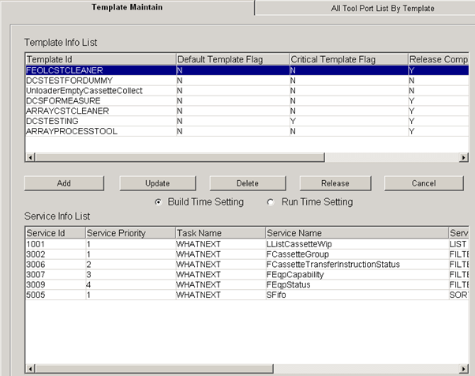
DCS →Template Maintain 1
Can use Add,Update,Delete,Release and Cancel functions
List the WIPs of the specified EQP
CSTGroup must have the same machine settings
Cassette must not be in transit
EQP Capability must be ‘Y’
EQP status must be in 'IDLE', 'RUN', 'DMQC' state
FIFO (compared with LogOff Time)
Notes:
可使用Add,Update ,Delete ,Release 與 Cancel 的功能
List指定機台的WIP
CSTGroup必須機台設定相同
Cassette 必須不處於傳送中
Eqp Capability 必須為Y
機台 status 必須處於’IDLE’,’RUN’,’DMQC’狀態
先進先出（以LogOff Time 相比較

Slide 53
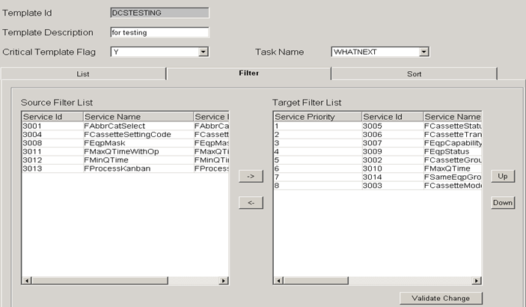
DCS → Template Maintain 2
Edit List, Filter and Sort rule

Slide 54
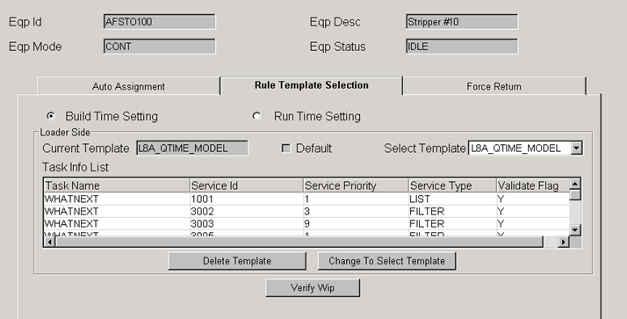
DCS → ToolAutoAssign

Slide 55
2.6.1 Process kanban Function #1
Purpose : When a workstation has too much WIP, it will easily cause the problem of Over Q-Time, so the number
of Cassettes completed by the previous workstation must be checked. Therefore, when screening the
workstation for delivery, it is necessary to check whether the WIP quantity of target_process_id exceeds
the set Kanban quantity. If it exceeds, the WIP Cassette will be filtered out.
ROUTE
The CVD machine will not automatically pull the goods, it is determined by the amount of WIP in the next station.
CLN
X
CVD
If the WIP of Photo has exceeded the set amount, the CVD machine at the previous station of Photo can stop automatic delivery until the WIP amount is less than the set amount.
PHOTO
Notes:
目的：針對某一站點其WIP太多時，會容易造成Over Q-Time的問題，
所以必須卡前一站做完的Cassette數量。因此對某一站做派貨篩選時，
需針對target_process_id的WIP數量是否超過所設定的Kanban數量，
若超過，則將WIP Cassette濾掉
CVD 機台不不會自動拉貨, 由下一站WIP的量來決定
如果Photo 的WIP 已經超過設定量, 那Photo 的前一站CVD 的機台可以停止自動派貨, 直到WIP 數量又小於設定量

Slide 56

2.6.2 Process kanban Function 2
Target Process Id:
Set the process id of the WIP of the process kanban count
Feedback Process Id:
Process Id for restricted WIP
In this case, when there are more than 5 cassettes whose process Id is AS-IEX, all the cassettes whose process Id is AS-CVD will not be pulled to EQP by DCS.
ROUTE
CLN
CVD
PHOTO
Notes:
Target Process Id:
欲設定process kanban count 的WIP
的Process id
Feedback Process Id:
受限制的WIP 的process Id
以此case 而言, 當process Id 為AS-IEX
的cassette超過５個時, 所裝有process Id
為AS-CVD 的cassette 都不會在ＤＣＳ被拉
到機台上去

